Slide 1
CI/CD technology for web application development
Rykov Oleksandr
EPAM DevOps Winter 2020-2021

Slide 2
Objective of the project is to study process ci/cd
Creation and implementation of continuous integration and delivery, using services such as:
GitHub (Version Control System)
Jenkins (CI/CD)
AWS (Cloud services)
Apache (Web server)
Ansible (Configuration management)
Docker (Container)

Slide 3

GitHub
GitHub is a provider of Internet hosting for software development and version control using Git. It offers the distributed version control and source code management (SCM) functionality of Git, plus its own features. It provides access control and several collaboration features such as bug tracking, feature requests, task management, continuous integration and wikis for every project

Slide 4

Jenkins
Jenkins is a free and open source automation server. It helps automate the parts of software development related to building, testing, and deploying, facilitating continuous integration and continuous delivery.

Slide 5

Prometheus
Prometheus is a free software application used for event monitoring and alerting. It records real-time metrics in a time series database built using a HTTP pull model, with flexible queries and real-time alerting.

Slide 6

Grafana
Grafana is a multi-platform open source analytics and interactive visualization web application. It provides charts, graphs, and alerts for the web when connected to supported data sources.

Slide 7





Project structure

Slide 8
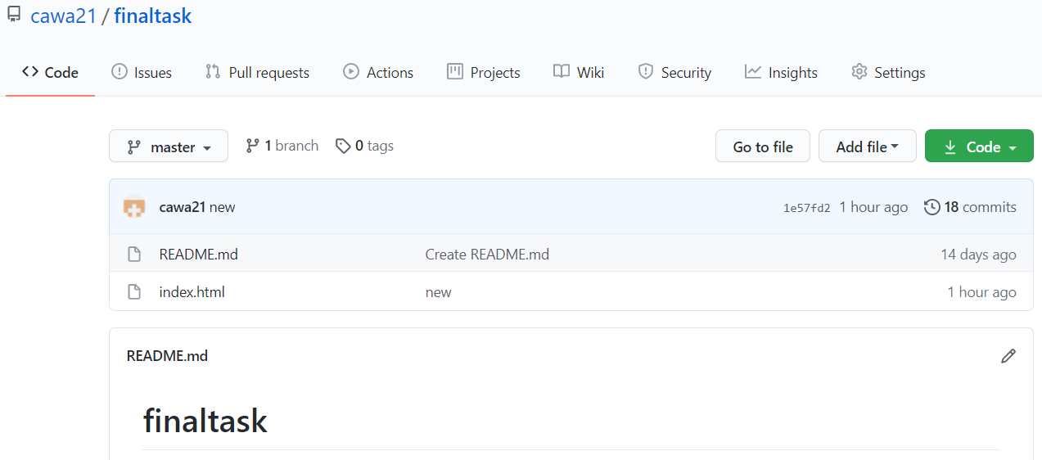
Github

Slide 9
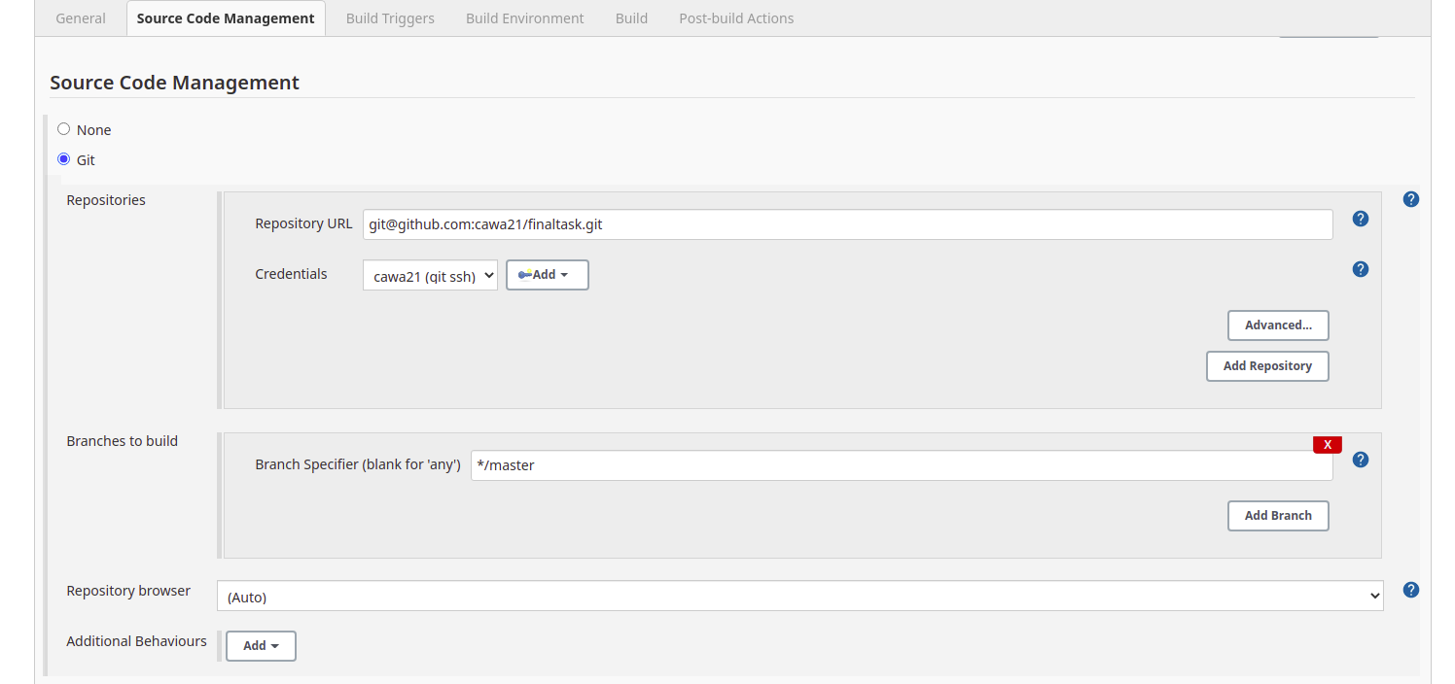
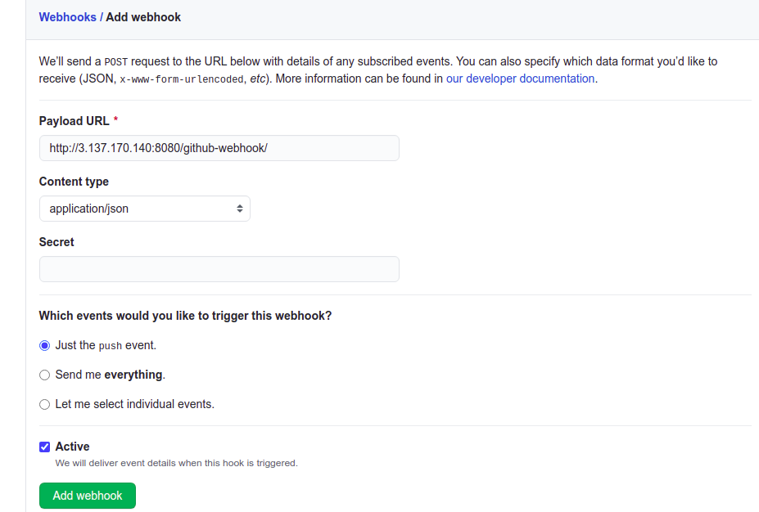
Webhook

Slide 10
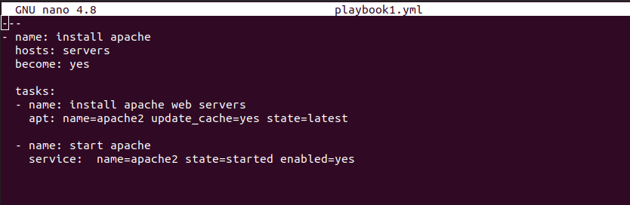
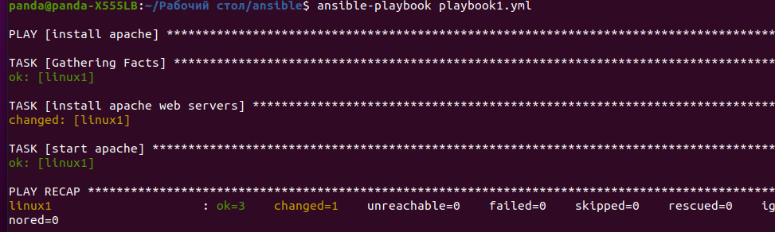
Apache

Slide 11
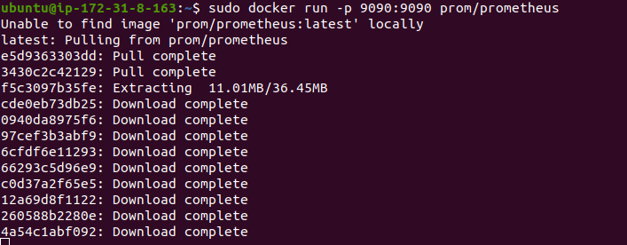
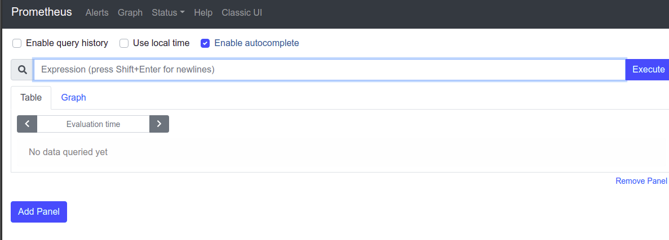
Prometheus

Slide 12
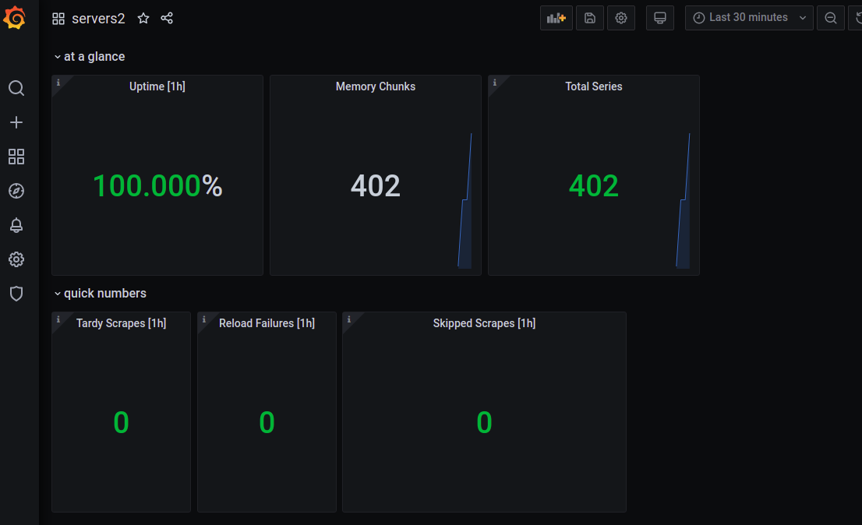
Grafana

Slide 13
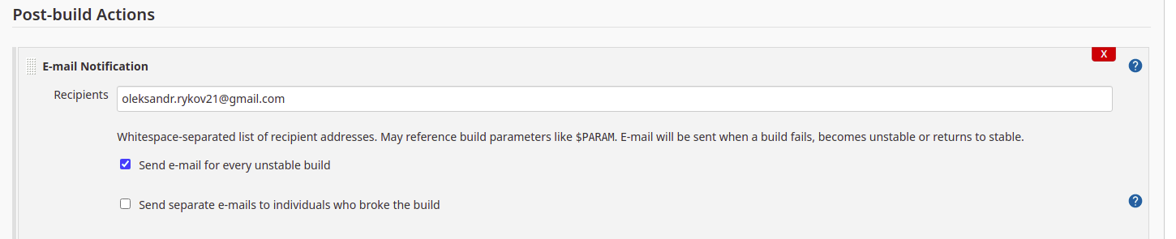
Notifications

Slide 14

Thank You for attention!

Slide 15
Q&A

